Slide 1

N.KRISHNAMOORTHY
ASSOCIATE PROFESSOR
School Of Information Technology & Engineering
VIT UNIVERSITY

Slide 2
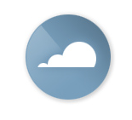
Agenda
Example and need for Cloud Computing
Define
Cloud Computing
Advantages and Disadvantages
Essential Characteristics, Key components
Cloud Delivery( Service) Models SaaS, PaaS and IaaS
Cloud Deployment Models- Public, Private, Hybrid, Community

Slide 3
Computing
Computing – Compute – Meaning – Calculate
Compute – Latin Word
COMPUTER = Arithmetical Logical Unit (ALU) + Control Unit (CU)
Perform some Computation by accepting Input, Storing , Processing and displaying results.
If we want to perform computation we need Resources.
Resources include servers, operating systems, networks, software, applications, and storage equipment.
For examples of if an application that you want to compute is a small one then an individual Computer Resource itself sufficient to perform it.
If an application is of scientific, mathematical, and academic problems like drug discovery, economic forecasting, seismic analysis back office data processing in support of e-commerce .

Slide 4
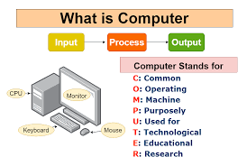
Computer is not an Intelligent Machine.
Digital Computers: • They use digital circuits and are designed to operate on two states, namely bits 0 and 1.
They are analogous to states ON and OFF. Data on these computers is represented as a series of 0s and 1s.
Computer is not an Acronym word.

Slide 5
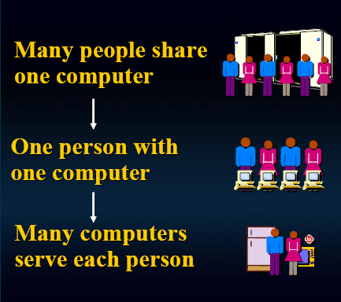
Current State

Slide 6
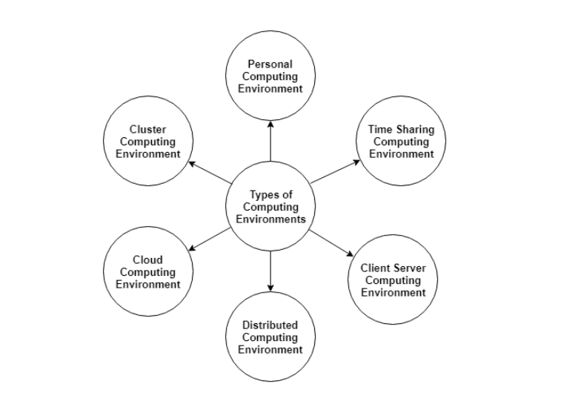
A computer system uses many devices, arranged in different ways to solve many problems. This constitutes a computing environment where many computers are used to process and exchange information to handle multiple issues.
Different Computing Environments

Slide 7
Computing Environments
Personal Computing Environment
In the personal computing environment, there is a single computer system. All the system processes are available on the computer and executed there.
Time Sharing Computing Environment
The time sharing computing environment allows multiple users to share the system simultaneously. Each user is provided a time slice and the processor switches rapidly among the users according to it. Because of this, each user believes that they are the only ones using the system.
Client Server Computing Environment
In client server computing, the client requests a resource and the server provides that resource. A server may serve multiple clients at the same time while a client is in contact with only one server. Both the client and server usually communicate via a computer network but sometimes they may reside in the same system.

Slide 8
Computing Environments
Distributed Computing Environment : In a distributed computing environment multiple nodes are connected together using network but physically they are separated. A single task is performed by different functional units of different nodes of distributed unit. Here different programs of an application run simultaneously on different nodes, and communication happens in between different nodes of this system over network to solve task.
Cloud Computing Environment : In cloud computing environment on demand availability of computer system resources like processing and storage are availed. Here computing is not done in individual technology or computer rather it is computed in cloud of computers where all required resources are provided by cloud vendor.
Grid Computing Environment : In grid computing environment, multiple computers from different locations works on single problem. In this system set of computer nodes running in cluster jointly perform a given task by applying resources of multiple computers/nodes. It is network of computing environment where several scattered resources provide running environment for single task.
Cluster Computing Environment : In cluster computing environment cluster performs task where cluster is a set of loosely or tightly connected computers that work together. It is viewed as single system and performs task parallelly that’s why also it is similar to parallel computing environment. Cluster aware applications are especially used in cluster computing environment.

Slide 9
Computing- Contd..
Then the individual computer is not sufficient to perform Computation
Solution sharing the resources with others
We have different computations like
Distributed Computing
A distributed system is a model in which components located on networked computers communicate and coordinate their actions by passing messages. Homogeneous, Static ,Many to Single Image
Grid Computing
Grid computing is the collection of computer resources from multiple locations to reach a common goal. Heterogeneous, Dynamic, Scientific –Many to Single Image

Slide 10
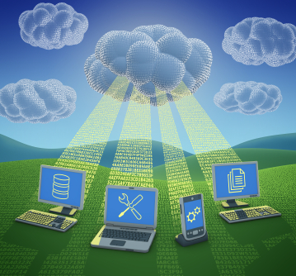
Cloud Computing
Cloud Computing
Cloud Computing is a method of providing a set of shared computing resources that includes applications, computing , storage, networking, development and deployment of platforms, as well as business process.
Business Community- IaaS
End User- SaaS
Developer-PaaS
Utility Computing: pay-as-you-go computing
Delivering applications and services over the Internet
Example day to day life we uses Face Book, Internet Banking and Gmail

Slide 11
What is Cloud Computing?
Cloud Computing
The “Cloud” is the default symbol of the internet in diagrams.
The broader term of “Computing” encompasses:
Computation
Coordination logic
Storage
Cloud Computing is about moving computing from the single desktop pc/data centers to the internet.

Slide 12
5 Essential Cloud Characteristics
On-demand self-service
Broad network access
Resource pooling
Location independence
Rapid elasticity
Measured service
Pay as you go.

Slide 13
Essential Characteristics
On-demand self-service
A consumer can unilaterally provision computing capabilities, such as server time and network storage, as needed automatically without requiring human interaction with each service provider.
Broad network access
Capabilities are available over the network and accessed through standard mechanisms that promote use by heterogeneous thin or thick client platforms (e.g., mobile phones, tablets, laptops, and workstations).

Slide 14
Characteristics
Rapid elasticity
Capabilities can be expanded or released automatically (i.e., more cpu power, or ability to handle additional users)
To the customer this appears seamless, limitless, and responsive to their changing requirements
Measured service
Customers are charged for the services they use and the amounts
There is a metering concept where customer resource usage can be monitored, controlled, and reported, providing transparency for both the provider and consumer of the utilized service

Slide 15
Essential Characteristics-Contd..
Resource pooling
The provider’s computing resources are pooled to serve multiple consumers
Resources can be dynamically assigned and reassigned according to customer demand
Customer generally may not care where the resources are physically located but should be aware of risks if they are located offshore

Slide 16
Advantages of Cloud Computing
Lower computer costs:
You do not need a high-powered and high-priced computer to run cloud computing's web-based applications.
Since applications run in the cloud, not on the desktop PC, your desktop PC does not need the processing power or hard disk space demanded by traditional desktop software.
When you are using web-based applications, your PC can be less expensive, with a smaller hard disk, less memory, more efficient processor...
In fact, your PC in this scenario does not even need a CD or DVD drive, as no software programs have to be loaded and no document files need to be saved.

Slide 17
Advantages of Cloud Computing
Improved performance:
With few large programs hogging your computer's memory, you will see better performance from your PC.
Computers in a cloud computing system boot and run faster because they have fewer programs and processes loaded into memory…
Reduced software costs:
Instead of purchasing expensive software applications, you can get most of what you need for free-ish!
most cloud computing applications today, such as the Google Docs suite.
better than paying for similar commercial software
which alone may be justification for switching to cloud applications.

Slide 18
Advantages of Cloud Computing
Instant software updates:
Another advantage to cloud computing is that you are no longer faced with choosing between obsolete software and high upgrade costs.
When the application is web-based, updates happen automatically
available the next time you log into the cloud.
When you access a web-based application, you get the latest version
without needing to pay for or download an upgrade.
Improved document format compatibility.
You do not have to worry about the documents you create on your machine being compatible with other users' applications or OSes
There are potentially no format incompatibilities when everyone is sharing documents and applications in the cloud.

Slide 19
Advantages of Cloud Computing
Unlimited storage capacity:
Cloud computing offers virtually limitless storage.
Your computer's current 1 Tbyte hard drive is small compared to the hundreds of Pbytes available in the cloud.
Increased data reliability:
Unlike desktop computing, in which if a hard disk crashes and destroy all your valuable data, a computer crashing in the cloud should not affect the storage of your data.
if your personal computer crashes, all your data is still out there in the cloud, still accessible
In a world where few individual desktop PC users back up their data on a regular basis, cloud computing is a data-safe computing platform!

Slide 20
Advantages of Cloud Computing
Universal document access:
That is not a problem with cloud computing, because you do not take your documents with you.
Instead, they stay in the cloud, and you can access them whenever you have a computer and an Internet connection
Documents are instantly available from wherever you are
Latest version availability:
When you edit a document at home, that edited version is what you see when you access the document at work.
The cloud always hosts the latest version of your documents
as long as you are connected, you are not in danger of having an outdated version

Slide 21
Advantages of Cloud Computing
Easier group collaboration:
Sharing documents leads directly to better collaboration.
Many users do this as it is an important advantages of cloud computing
multiple users can collaborate easily on documents and projects
Device independence.
You are no longer tethered to a single computer or network.
Changes to computers, applications and documents follow you through the cloud.
Move to a portable device, and your applications and documents are still available.

Slide 22
Disadvantages of Cloud Computing
Requires a constant Internet connection:
Cloud computing is impossible if you cannot connect to the Internet.
Since you use the Internet to connect to both your applications and documents, if you do not have an Internet connection you cannot access anything, even your own documents.
A dead Internet connection means no work and in areas where Internet connections are few or inherently unreliable, this could be a deal-breaker.

Slide 23
Disadvantages of Cloud Computing
Does not work well with low-speed connections:
Similarly, a low-speed Internet connection, such as that found with dial-up services, makes cloud computing painful at best and often impossible.
Web-based applications require a lot of bandwidth to download, as do large documents.
Features might be limited:
This situation is bound to change, but today many web-based applications simply are not as full-featured as their desktop-based applications.
For example, you can do a lot more with Microsoft PowerPoint than with Google Presentation's web-based offering

Slide 24
Disadvantages of Cloud Computing
Can be slow:
Even with a fast connection, web-based applications can sometimes be slower than accessing a similar software program on your desktop PC.
Everything about the program, from the interface to the current document, has to be sent back and forth from your computer to the computers in the cloud.
If the cloud servers happen to be backed up at that moment, or if the Internet is having a slow day, you would not get the instantaneous access you might expect from desktop applications.

Slide 25
Disadvantages of Cloud Computing
Stored data might not be secure:
With cloud computing, all your data is stored on the cloud.
The questions is How secure is the cloud?
Can unauthorised users gain access to your confidential data?
Stored data can be lost:
Theoretically, data stored in the cloud is safe, replicated across multiple machines.
But on the off chance that your data goes missing, you have no physical or local backup.
Put simply, relying on the cloud puts you at risk if the cloud lets you down.

Slide 26
Benefits of Cloud
Business Benefits of Cloud Computing
Technical Benefits of Cloud Computing
26

Slide 27
Business Benefits
Almost zero upfront infrastructure investment
Just-in-time Infrastructure
More efficient resource utilization
Usage-based costing
Reduced time to market
27

Slide 28
Technical Benefits
Automation – “Scriptable infrastructure”
Auto-scaling
Proactive Scaling
More Efficient Development lifecycle
Improved Testability
Disaster Recovery and Business Continuity
28

Slide 29
Limitations
Down Time
- Technical outage, Internet connection offline
Security
- Hackers
Vendor Lock-in
- Migrate Services
Limited Control
- Administrative Controls
29

Slide 30
Cloud Computing - Key Components
Pay as you go
Access from anywhere, anytime, any device
Economy of scale
Flexibility
Expertly Managed
Notes:
Make less techie ..
Add talking points to each bullet

Slide 31
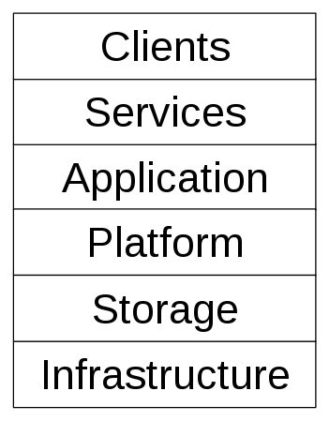
Cloud Components
31

Slide 32
Cloud Components
Infrastructure
Cloud infrastructure, such as Infrastructure as a service, is the delivery of computer infrastructure, typically a platform virtualization environment, as a service
For example:
Full virtualization - eg. GoGrid
Grid computing – eg. Sun Grid
Compute - eg. Amazon Elastic Compute Cloud
32

Slide 33
Cloud Components
Storage
Cloud storage involves the delivery of data storage as a service including database-like services, often billed on a utility computing basis, e.g., per gigabyte per month.
For example:
Database - Amazon SimpleDB
Web service - Amazon Simple Storage Service, Nirvanix
33

Slide 34
Cloud Components
Platform
A cloud platform, such as Platform as a service, the delivery of a computing platform, and/or solution stack as a service facilitates deployment of applications without the cost and complexity of buying and managing the underlying hardware and software layers.
For example:
Web application frameworks,
Ajax (Caspio)
Python Django (Google App Engine)
Web hosting,
Mosso
34

Slide 35
Cloud Components
Application
A cloud application leverages the Cloud in Software Architecture, often eliminating the need to install and run the application on the customer's own computer, thus preventing the burden of software maintenance, ongoing operation, and support.
Web Application – eg. Facebook
Software as a service eg. Google Apps
Software Plus Services eg. Microsoft Online Services
35

Slide 36
Cloud Components
Service
A cloud service includes "products, services and solutions that are delivered and consumed in real-time over the Internet.
For example,
Identity - OpenID
Payments - e Payments services, PayPal
Mapping - Google Maps, Yahoo! Maps
Search - Google Custom Search, Yahoo search
36

Slide 37
Cloud Components
Client
A cloud client consists of computer hardware and/or computer software which relies on The Cloud for application delivery, or which is specifically designed for delivery of cloud services and which, in either case, is essentially useless without it.
Mobile - eg. Android , Iphone
Thick client / Web browser - eg. Google Chrome, Mozilla Firefox
37

Slide 38
Models
Service or Delivery Models
Software as a Service
Platform as a Service
Infrastructure as a Service
(Broadly Everything as a Service)
Deployment Models
Private Cloud
Community Cloud
Public Cloud
Hybrid Cloud

Slide 39
Deployment Models
Public Cloud
i) Open for public & Free
ii) Utility model, Shared hardware
iii) Self-managed (e.g., AWS, Azure, GCE)
iv) Example : Google, Facebook, Twitter
Private Cloud
i) Belongs to a particular Corporate
ii) Protected by Firewall
iii) More isolated (secure?),
iv) Example: IBM Cloud
39

Slide 40
Deployment Models
Community Cloud
i) For organizations and Business that works on
Joint venture, tenders & Research.
ii) Setup is mutually shared between many
organisations that belong to a particular
community Eg. Banks.
Hybrid Cloud
i) Its an integrated arrangement of two or more
servers.
ii) Eg. E-commerce web site.
40

Slide 41
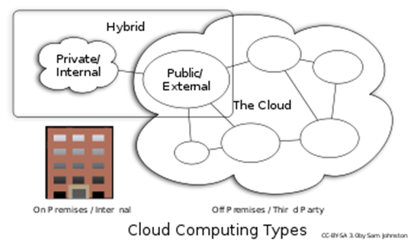
Cloud Deployment Models
Private cloud
single org only,
managed by the org
or a 3rd party,
on or off premise
Community cloud
shared infrastructure for specific community
several orgs that have shared concerns,
managed by org or a 3rd party
Notes:
Private cloud. The cloud infrastructure is operated solely for an organization. It may be managed by the organization or a third party and may exist on premise or off premise.
Community cloud. The cloud infrastructure is shared by several organizations and supports a specific community that has shared concerns (e.g., mission, security requirements, policy, and compliance considerations). It may be managed by the organizations or a third party and may exist on premise or off premise.
Public cloud. The cloud infrastructure is made available to the general public or a large industry group and is owned by an organization selling cloud services.
Hybrid cloud. The cloud infrastructure is a composition of two or more clouds (private, community, or public) that remain unique entities but are bound together by standardized or proprietary technology that enables data and application portability (e.g., cloud bursting).

Slide 42
Cloud Deployment Models (Cont.)
Public cloud
Sold to the public, mega-scale infrastructure
available to the general public
Hybrid cloud
composition of two or more clouds
bound by standard or proprietary technology

Slide 43
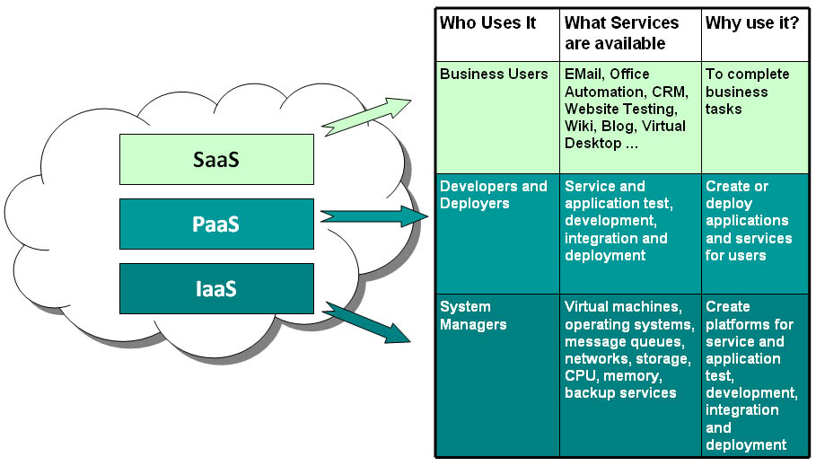
Cloud Computing – Delivery Models
Software as a Service - SaaS
Platform as a Service - PaaS
Infrastructure as a Service - IaaS
Notes:
add real examples here as needed.

Slide 44
Service Models
44

Slide 45
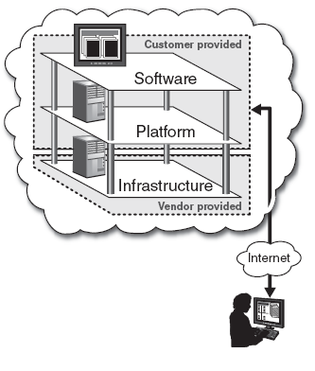
Service Models
Infrastructure-as-a-Service (IaaS)
A service model that involves outsourcing the basic infrastructure used to support operations--including storage, hardware, servers, and networking components.
The service provider owns the infrastructure equipment and is responsible for housing, running, and maintaining it. The customer typically pays on a per-use basis.
The customer uses their own platform (Windows, Unix), and applications

Slide 46
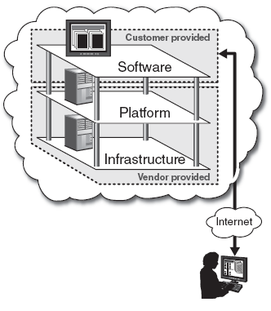
Service Models
Platform-as-a-Service (PaaS)
A service model that involves outsourcing the basic infrastructure and platform (Windows, Unix)
PaaS facilitates deploying applications without the cost and complexity of buying and managing the underlying hardware and software where the applications are hosted.
The customer uses their own applications

Slide 47
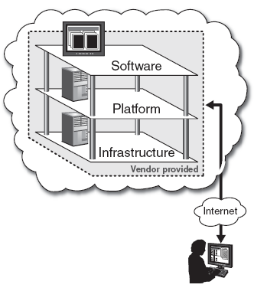
Service Models
Software-as-a-Service (SaaS)
Also referred to as “software on demand,” this service model involves outsourcing the infrastructure, platform, and software/applications.
Typically, these services are available to the customer for a fee, pay-as-you-go, or a no charge model.
The customer accesses the applications over the internet.

Slide 48
Other Services
Storage-as-a-service
Database-as-a-service
Information-as-a-service
Process-as-a-service
Application-as-a-service
Integration-as-a-service
Security-as-a-service
Mgt/Governance-as-a-service
Testing-as-a-service
Network-as-a-Service
Communication-as-a-Service
Analytics-as-a-Service

Slide 49
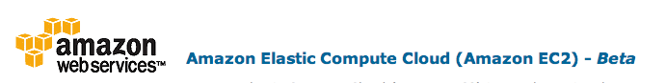


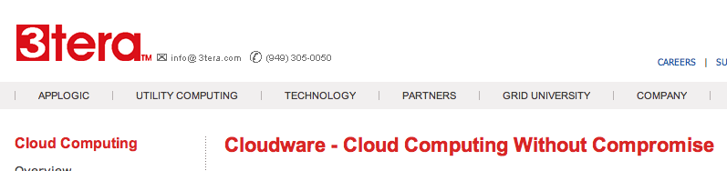






Some Commercial Cloud Offerings

Slide 50
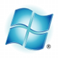
Windows Azure
Enterprise-level on-demand capacity builder
Fabric of cycles and storage available on-request for a cost
You have to use Azure API to work with the infrastructure offered by Microsoft
Significant features: web role, worker role , blob storage, table and drive-storage

Slide 51

Amazon EC2
Amazon EC2 is one large complex web service.
EC2 provided an API for instantiating computing instances with any of the operating systems supported.
It can facilitate computations through Amazon Machine Images (AMIs) for various other models.
Signature features: S3, Cloud Management Console, MapReduce Cloud, Amazon Machine Image (AMI)
Excellent distribution, load balancing, cloud monitoring tools

Slide 52

Google App Engine
This is more a web interface for a development environment that offers a one stop facility for design, development and deployment Java and Python-based applications in Java, Go and Python.
Google offers the same reliability, availability and scalability at par with Google’s own applications
Interface is software programming based
Comprehensive programming platform irrespective of the size (small or large)
Signature features: templates and appspot, excellent monitoring and management console

Slide 53
Virtualization
Virtualization is the ability to run multiple operating systems on a single physical system and share the underlying hardware resources*
It is the process by which one computer hosts the appearance of many computers.
Virtualization is used to improve IT throughput and costs by using physical resources as a pool from which virtual resources can be allocated.
*VMWare white paper, Virtualization Overview

Slide 54
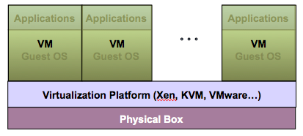
Virtualization Architecture
A Virtual machine (VM) is an isolated runtime environment (guest OS and applications)
Multiple virtual systems (VMs) can run on a single physical system

Slide 55
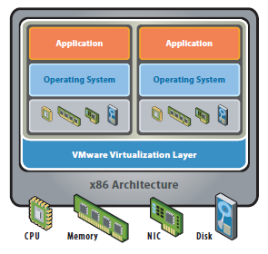
Virtual Server Model
Notes:
Hardware-independence of operating system and applications
Virtual machines can be provisioned to any system
Can manage OS and application as a single unit by encapsulating them into virtual machines

Slide 56
Virtualization - Why Virtualize?
Reduce Real Estate Needs
Increase Up Time
Reduce CO2 Emmissions, Power and Cooling Requirements
Increase Flexibility
Reduce Overall Costs
Notes:
More out of less Pool common infrastructure resources and break the legacy “one application to one server” model with server consolidation.

Slide 57
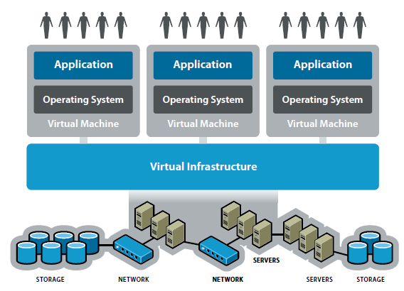
Massively Virtualized Model - Cloud
Notes:
Use this as a way to describe the cloud concept.
When completely virtualized, allows for the key components of cloud computing, elasticity, provisioning, self service, etc.

Slide 58
Big-Data
Big data is a term applied to data sets whose size is beyond the ability of commonly used software tools to capture, manage and process the data within a tolerable elapsed time.
Petabytes, exabytes, zettabytes.

Slide 59
Our Data-driven World
Science
Data bases from astronomy, genomics, environmental data, transportation data, …
Humanities and Social Sciences
Scanned books, historical documents, social interactions data, …
Business & Commerce
Corporate sales, stock market transactions, census, airline traffic, …
Entertainment
Internet images, Hollywood movies, MP3 files, You Tube…
Medicine
MRI & CT scans, patient records, …

Slide 60
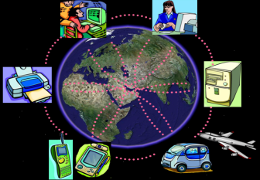
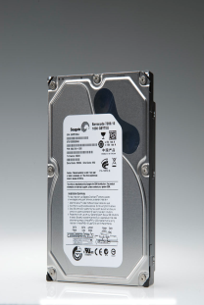
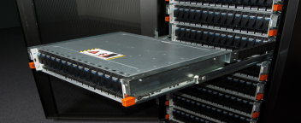
Data-rich World
Data capture and collection:
Highly instrumented environment
Sensors and Smart Devices
Network
Data storage:
Seagate 1 TB Barracuda @ $72.95 from Amazon.com (73¢/GB)

Slide 61
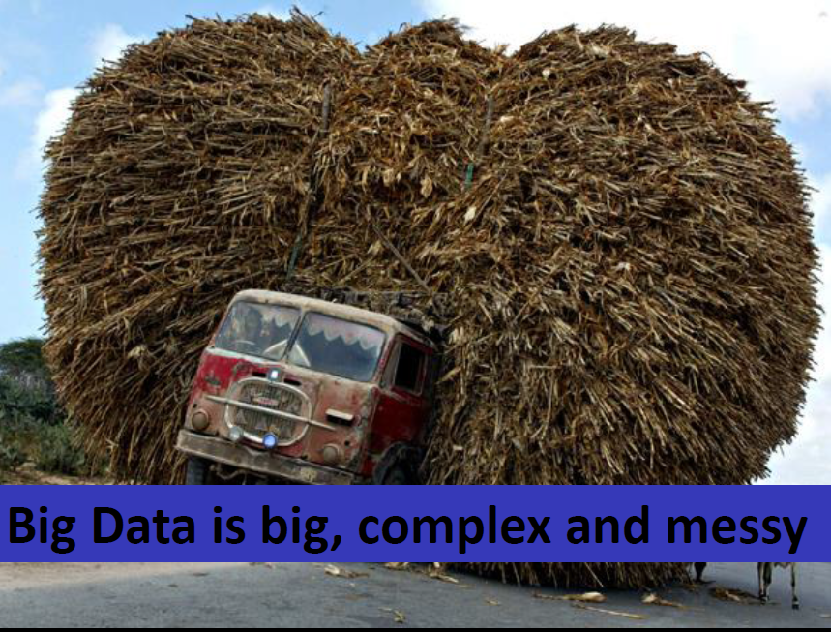

Slide 62
Decision Making
Data

Slide 63
Synergy between Big Data and Cloud

Slide 64
Big Data Requirements | Synergic Cloud Characteristics
Massive compute resource required for processing on demand | Infinite compute resource on demand – h/w virtualization
Accessibility anytime and anywhere | Internet based, Reduced costs, dynamic hw provisioning, Pay per use
Elimination of upfront commitment of users | No need to plan for peak load in advance
Easy management | Self management Software versioning and upgrading
Handle complex workloads | simple distributed programming models
Size | Elastic - Terabyte, Petabyte …
Structure: Structured, Unstructured : Audio, Video, Text, GeoSpatial, Schema Less Structures | Holder. Storing articles and data conversions faster

Slide 65
Potential Benefits of Applying Cloud Computing For Big data Management

Slide 66
Analytics as a Service
Why Analytics cant be served as a Service?
Analytics as a Service (AaaS) refers to the provision of analytics software and operations through Web-delivered technologies.
These types of solutions offer businesses an alternative to developing internal hardware setups just to perform business analytics.
Analytics as a Service is becoming a valuable option for businesses because setting up analytics processes can be a work-intensive process.
Businesses that need to do more analytics may need more servers and other kinds of hardware, and they may need more IT staff to implement and maintain these programs.

Slide 67
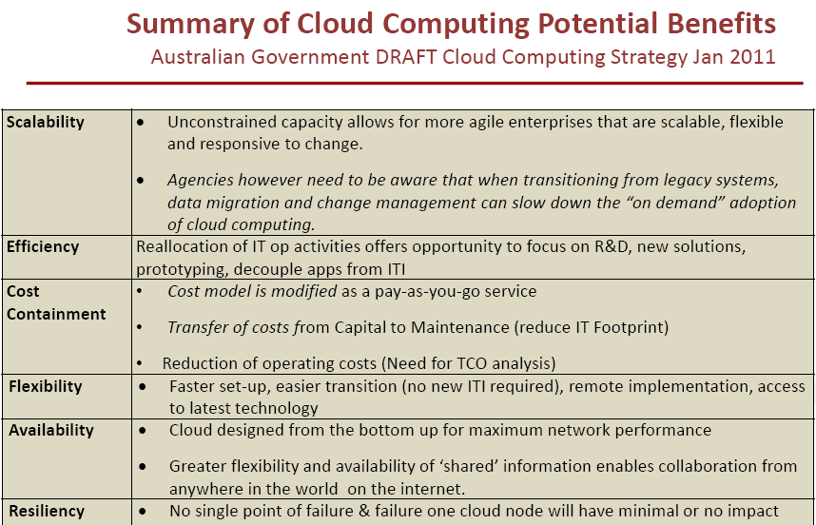

Slide 68
Thank You
68

